Slide 1
ACCIDENT SEVERITY PREDICTION

Slide 2
AGENDA
Problem Specification
What’s in data?
Models
6
4
2
5
1
3
Future Scope?
Introduction
Data Characteristics

Slide 3





TEAM INTRODUCTION .
Vinay Kumar Moluguri
Akhilesh
Sandeep
Venkat Gopinath
Naveen

Slide 4




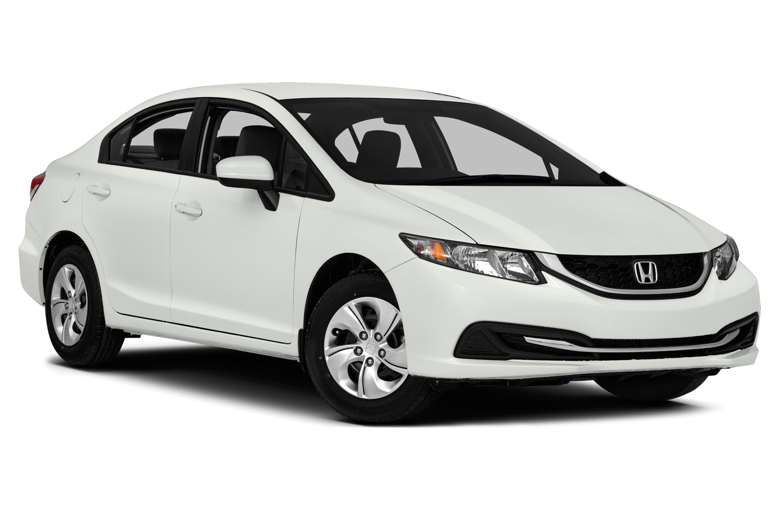



Road traffic crashes rank as the 9th leading cause of death and accounts for 2.2% of all deaths globally
20–50 million people are injured or disabled annually
On average, 3,287
deaths a day
Road crashes cost USD 518 billion globally, 1–2% of nation’s GDP
In the USA, over 37,000 people die in road crashes each year
Nearly 1.25 million people die in road crashes each year
Notes:
US 230 billion per year on average of 820 per person
Road crashes are the single greatest annual cause of death of healthy U.S. citizens travelling abroad.

Slide 5


INDUSTRY & APPLICATIONS
INSURANCE INDUSTRY
GOVERNMENT
Accident severity is the basis for both the premium for insurance that covers accidents & amount of money that an insurance company will release for the policyholder in the event of an accident.
Helps them plan for better healthcare services, emergency planning, traffic control, but most importantly in prevention of accidents in the future

Slide 6
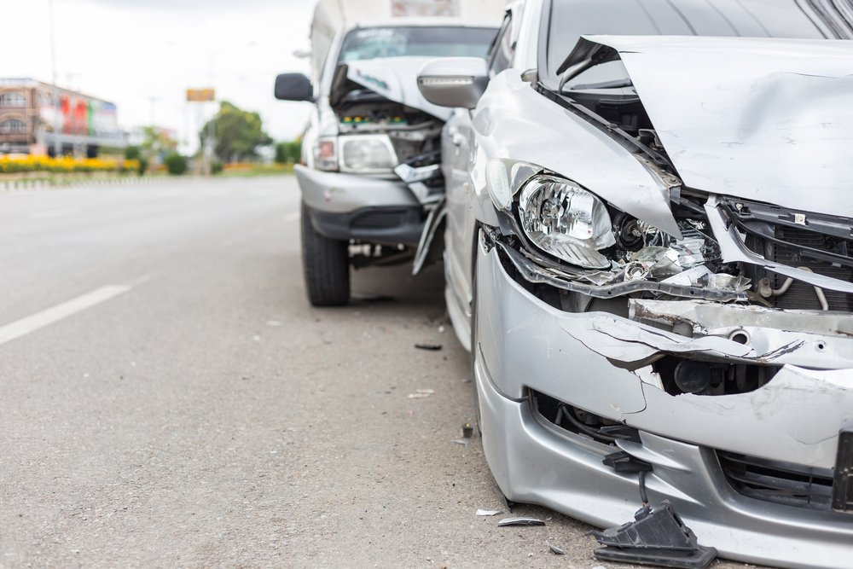
The least you’d want is losing someone to an accident

Slide 7

Accident Severity Prediction
Key factor affecting accidents
Objectives
Real-time accident prediction

Slide 8

1
5
Dataset contains data of US accidents during period of Feb 2016 to Dec 2020
State-wise data is considered for model experiments (considering dataset size)
2
6
4 Million Cases of Accidents
Data Attributes divided into 5 categories
3
7
DATASET OVERVIEW
Overall Data is considered for Exploratory Data Analysis
Shape of Data is (42,32,541,49)
4
8
Feb 2019 to Dec 2020 Data Period considered to remove irrelevant factors
Source: Kaggle

Slide 9
DATA
ATTRIBUTES
TRAFFIC ATTRIBUTES
05
01
PERIOD OF THE DAY
POI
ATTRIBUTES
ADDRESS ATTRIBUTES
02
04
WEATHER ATTRIBUTES
03

Slide 10








TRAFFIC ATTRIBUTES
Accident ID
Start Lat
01
07
Shows latitude in GPS coordinate of the start point.
This is a unique identifier of the accident record.
Source
Start Lng
02
Indicates source of the accident report (i.e. the API which reported the accident.).
08
Shows longitude in GPS coordinate of the start point.
03
TMC
09
End Lat
A Traffic Message Channel (TMC) code which provides more detailed description of the event.
Shows latitude in GPS coordinate of the end point.
04
Severity
10
End Lng
Shows the severity of the accident, a number between 1 and 4
Shows longitude in GPS coordinate of the end point.
05
Start time
11
Distance
Shows start time of the accident in local time zone.
The length of the road extent affected by the accident.
End time
Description
06
12
Shows end time of the accident in local time zone.
Shows natural language description of the accident.

Slide 11








ADDRESS ATTRIBUTES
01
Number
Shows the street number in address field.
State
07
Shows the state in address field.
02
Street
Shows the street name in address field.
Zip code
08
Shows the zipcode in address field.
03
Side
Shows the relative side of the street (Right/Left) in address field.
09
Country
Shows the country in address field.
04
City
Shows the city in address field.
Timezone
10
Shows timezone based on the location of the accident (eastern, central, etc.)
05
County
Shows the county in address field.

Slide 12








WEATHER ATTRIBUTES
01
Airport Code
Denotes an airport-based weather station which is the closest one to location of the accident.
07
Visibility(mi)
Weather Timestamp
Shows visibility (in miles).
02
Shows the time-stamp of weather observation record (in local time).
08
Wind Direction
Temperature (F)
Shows wind direction.
03
Shows the temperature (in Fahrenheit).
09
Wind Speed (mph)
Wind Chill(F)
Shows wind speed (in miles per hour).
04
Shows the wind chill (in Fahrenheit).
Precipitation (in)
10
Shows precipitation amount in inches, if there is any.
05
Humidity(%)
Shows the humidity (in percentage).
Weather Condition
11
Shows the weather condition (rain, snow, thunderstorm, fog, etc.).
06
Pressure(in)
Shows the air pressure (in inches).

Slide 13












POINT OF INTEREST ATTRIBUTES
Amenity
Railway
01
07
A POI annotation which indicates presence of railway in a nearby location.
A Point-Of-Interest (POI) annotation which indicates presence of amenity in a nearby location.
Bump
Roundabout
02
A POI annotation which indicates presence of speed bump or hump in a nearby location.
08
A POI annotation which indicates presence of roundabout in a nearby location
03
Crossing
09
Station
A POI annotation which indicates presence of crossing in a nearby location.
A POI annotation which indicates presence of station (bus, train, etc.) in a nearby location
04
Give Way
10
Stop
A POI annotation which indicates presence of give_way sign in a nearby location.
A POI annotation which indicates presence of stop sign in a nearby location
Junction
Traffic Calming
05
11
A POI annotation which indicates presence of traffic_calming means in a nearby location.
A POI annotation which indicates presence of junction in a nearby location.
No Exit
Traffic Signal
06
A POI annotation which indicates presence of no_exit sign in a nearby location
12
A POI annotation which indicates presence of traffic_signal in a nearby location.

Slide 14

PERIOD OF THE DAY ATTRIBUTES
01
Sunrise/Sunset
Shows the period of day (i.e. day or night) based on sunrise/sunset.
Civil Twilight
02
Shows the period of day (i.e. day or night) based on civil twilight.
Nautical Twilight
03
Shows the period of day (i.e. day or night) based on nautical twilight.
Astronomical Twilight
04
Shows the period of day (i.e. day or night) based on astronomical twilight.

Slide 15
Data Cleaning & Pre-Processing
02
04
01
Dropped
Unnecessary Features
03
Cleaned up Categorical Data
After analysis of what features are impacting the prediction vs unnecessary features, we removed unnecessary features for further evaluation
After identifying the categorical data, we cleaned up the categorical data for better prediction purposes
Fixed datetime format
Dropped and Imputed Missing Values
Different data points of timezone and date time had different formats which were fixed and corrected to one datetime format
After analysing which rows had missing values and depending on different criterias, we dropped and imputed missing values for various columns

Slide 16
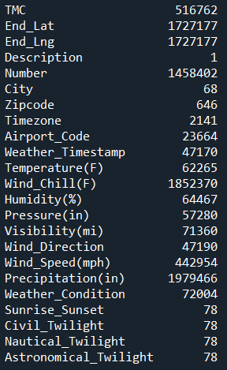
HANDLING MISSING DATA
Feature | Missing_Percent(%)
Number | 60.026676
City | 0.001999
Zipcode | 0.013462
Timezone | 0.087222
Airport_Code | 0.177649
Temperature(F) | 1.708008
Wind_Chill(F) | 53.724535
Humidity(%) | 1.821589
Pressure(in) | 1.465273
Visibility(mi) | 1.998672
Wind_Direction | 1.517463
Wind_Speed(mph) | 12.992687
Precipitation(in) | 57.669350
Sunrise_Sunset | 0.002149
Civil_Twilight | 0.002149
Nautical_Twilight | 0.002149
Astronomical_Twilight | 0.002149
Clear | 1.995995
Cloud | 1.995995
Rain | 1.995995
Heavy_Rain | 1.995995
Snow | 1.995995
Heavy_Snow | 1.995995
Fog | 1.995995
Categorical Data
Side
Country
Timezone
Amenity
Bump
Crossing
Give_Way
Junction
No_Exit
Railway
Roundabout
Station
Stop
Traffic_Calming
Traffic_Signal
Turning_Loop
Sunrise_Sunset
Civil_Twilight
Nautical_Twilight
Astronomical_Twilight

Slide 17




Data Cleaning & Pre-Processing
Dropped Data
(Unnecessary Features)
Dropped Data
(Missing Percentage)
Dropped Data
(Basis NA of columns)
Values Imputed
(With mean/median of column)
TMC
Distance(Mi)
End Time(We have start time)
Duration
End Lat
End Lng
Description (POI features pulled already)
Number
Wind Chill
Precipitation
City
Zipcode
Airport_Code
Sunrise_Sunset
Civil_Twilight
Nautical_Twilight
Astronomical_Twilight
Temperature(F)
Humidity(%)
Pressure(in)
Visibility(mi)
Wind_Speed(mph)

Slide 18




METHODOLOGY & MODELS
IDEAS
Sampling
Under-sampling (We didn't use over-sampling because this dataset is large enough and over-sampling is very likely to casue overfitting)
Ensembling
EasyEnsemble
BalanceCascade
Models
Logistic Regression
KNN
Decision Tree
Random Forest

Slide 19

Logistic Regression
# Logistic regression
lr = LogisticRegression(random_state=0)
lr.fit(X_train,y_train)
y_pred=lr.predict(X_test)
# Get the accuracy score
acc=accuracy_score(y_test, y_pred)
# Append to the accuracy list
accuracy_lst.append(acc)
print("[Logistic regression algorithm] accuracy_score: {:.3f}.".format(acc))
[Logistic regression algorithm] accuracy_score:
0.954.

Slide 20
KNN Model
(With 6 Neighbors)
# Create a k-NN classifier with 6 neighbors
knn = KNeighborsClassifier(n_neighbors=6)
# Fit the classifier to the data
knn.fit(X_train,y_train)
# Predict the labels for the training data X
y_pred = knn.predict(X_test)
# Get the accuracy score
acc=accuracy_score(y_test, y_pred)
# Append to the accuracy list
accuracy_lst.append(acc)
print('[K-Nearest Neighbors (KNN)] knn.score: {:.3f}.'.format(knn.score(X_test, y_test)))
print('[K-Nearest Neighbors (KNN)] accuracy_score: {:.3f}.'.format(acc))
[K-Nearest Neighbors (KNN)] knn.score: 0.935.
[K-Nearest Neighbors (KNN)] accuracy_score: 0.935.

Slide 21
Decision Tree Model
# Decision tree algorithm
# Instantiate dt_entropy, set 'entropy' as the information criterion
dt_entropy = DecisionTreeClassifier(max_depth=8, criterion='entropy', random_state=1)
# Fit dt_entropy to the training set
dt_entropy.fit(X_train, y_train)
# Use dt_entropy to predict test set labels
y_pred= dt_entropy.predict(X_test)
# Evaluate accuracy_entropy
accuracy_entropy = accuracy_score(y_test, y_pred)
# Instantiate dt_gini, set 'gini' as the information criterion
dt_gini = DecisionTreeClassifier(max_depth=8, criterion='gini', random_state=1)
# Fit dt_entropy to the training set
dt_gini.fit(X_train, y_train)
# Use dt_entropy to predict test set labels
y_pred= dt_gini.predict(X_test)
# Evaluate accuracy_entropy
accuracy_gini = accuracy_score(y_test, y_pred)
[Decision Tree -- entropy] accuracy_score: 0.967.
[Decision Tree -- gini] accuracy_score: 0.968.

Slide 22
Random Forest
(n_estimators=100)
# Random Forest algorithm
#Create a Gaussian Classifier
clf=RandomForestClassifier(n_estimators=100)
#Train the model using the training sets y_pred=clf.predict(X_test)
clf.fit(X_train,y_train)
y_pred=clf.predict(X_test)
# Get the accuracy score
acc=accuracy_score(y_test, y_pred)
# Append to the accuracy list
accuracy_lst.append(acc)
# Model Accuracy, how often is the classifier correct?
print("[Randon forest algorithm] accuracy_score: {:.3f}.".format(acc))
[Random forest algorithm] accuracy_score:
0.974.

Slide 23
Random Forest
(Select the top important features, set the threshold)
# Create a selector object that will use the random forest classifier to identify
# features that have an importance of more than 0.03
sfm = SelectFromModel(clf, threshold=0.03)
# Train the selector
sfm.fit(X_train, y_train)
feat_labels=X.columns
# Transform the data to create a new dataset containing only the most important features
X_important_train = sfm.transform(X_train)
X_important_test = sfm.transform(X_test)
# Create a new random forest classifier for the most important features
clf_important = RandomForestClassifier(n_estimators=100, random_state=0, n_jobs=-1)
# Train the new classifier on the new dataset containing the most important features
clf_important.fit(X_important_train, y_train)
# Apply The Full Featured Classifier To The Test Data
y_pred = clf.predict(X_test)
# Apply The Full Featured Classifier To The Test Data
y_important_pred = clf_important.predict(X_important_test)
[Random forest algorithm -- Full feature] accuracy_score: 0.974.
[Random forest algorithm -- Limited feature] accuracy_score: 0.973.

Slide 24
Models Evaluation
AVERAGE
AVERAGE
AVERAGE
GOOD
GOOD
GOOD
95.4%
93.5%
96.7%
EXCELLENT
EXCELLENT
EXCELLENT
LOGISTIC REGRESSION
KNN SCORE
DECISION TREE (ENTROPY)
AVERAGE
AVERAGE
AVERAGE
GOOD
GOOD
GOOD
96.8%
97.4%
97.3%
EXCELLENT
EXCELLENT
EXCELLENT
DECISION TREE (GINI)
RANDOM FOREST (FULL)
RANDOM FOREST (LIMITED)

Slide 25
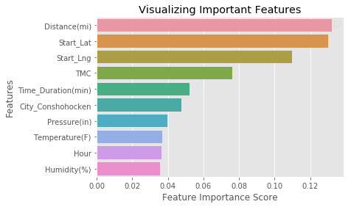
Visualizing Important Features
Distance(mi) 0.132071
Start_Lat 0.130219
Start_Lng 0.109706
TMC 0.076326
Time_Duration(min) 0.052122
City_Conshohocken 0.047735
Pressure(in) 0.039958
Temperature(F) 0.037064
Hour 0.036530
Humidity(%) 0.035586
Traffic_Signal 0.023557
Side_R 0.020803
City_Bala Cynwyd 0.014978
Junction 0.014384
City_King of Prussia 0.014276
Visibility(mi) 0.013930
City_Plymouth Meeting 0.011725
City_Narberth 0.009232
Weekday_Sun 0.007879
Weather_Condition_Overcast 0.007580

Slide 26




WHAT CAN WE DO WITH ANALYSED DATA?
Predict Real-time accidents and reduce associated risk
Improve traffic safety management and accident hotspots
Area wise accidents to predict trends, hotspots, improve healthcare
Preventing Accidents and mitigate deaths, injuries and property loss

Slide 27




Explore Relationships
Explore Re-Sampling and Frequency Encoding
Handling Class Imbalance
Real time accident risk prediction
FUTURE SCOPE

Slide 28
THERE IS SO MUCH MORE WE CAN DO!
THERE IS SO MUCH MORE WE CAN DO!
The data is speaking to us…
All we need to do is listen!

Slide 29

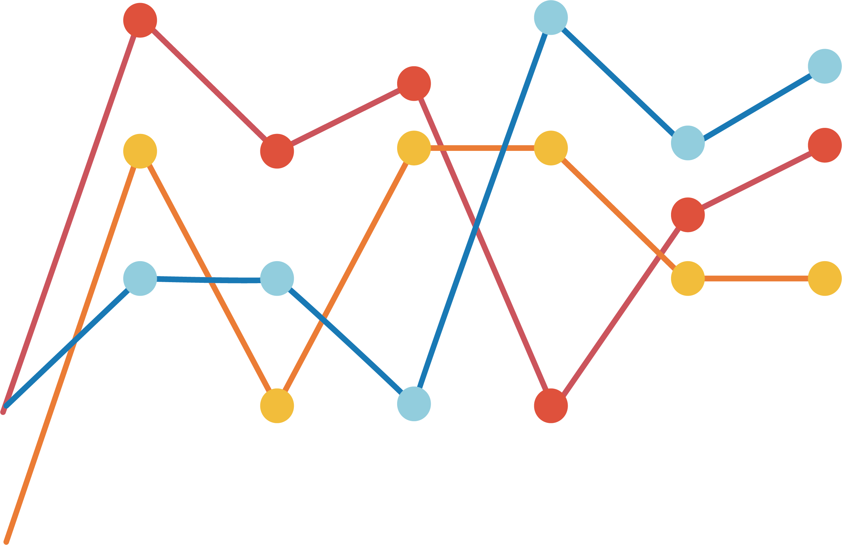




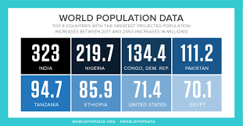

Slide 30
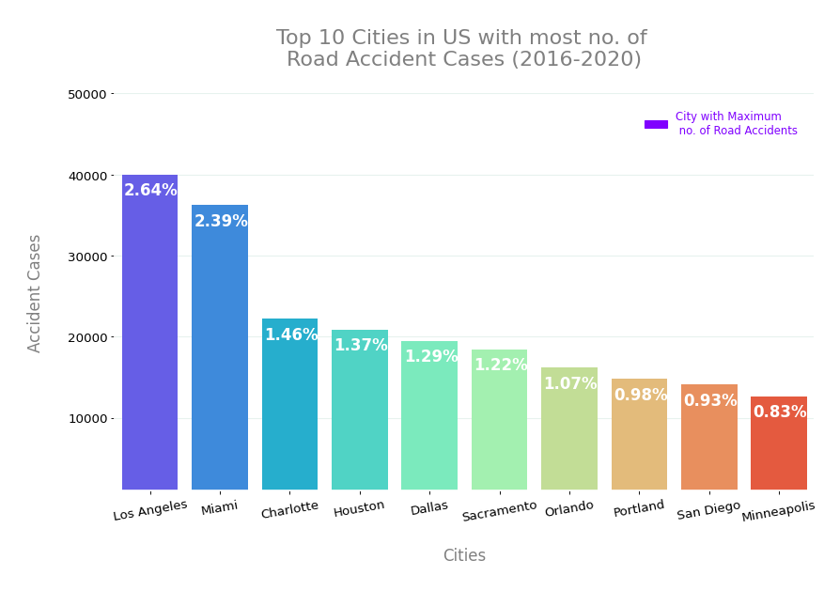

Slide 31
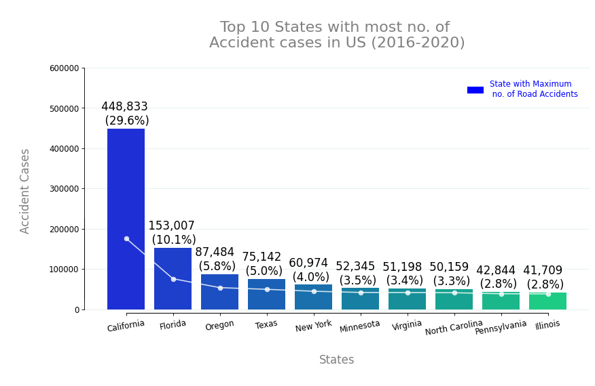

Slide 32
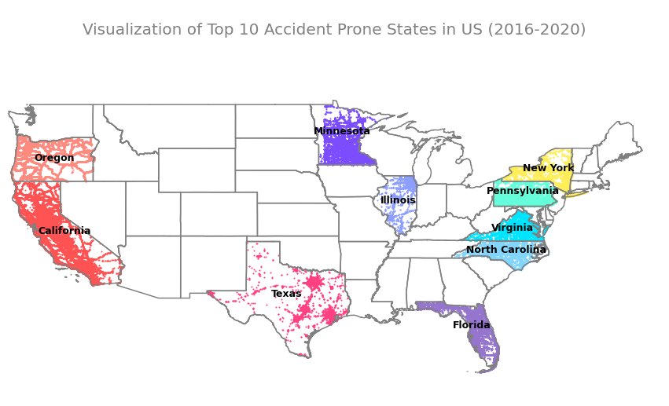

Slide 33
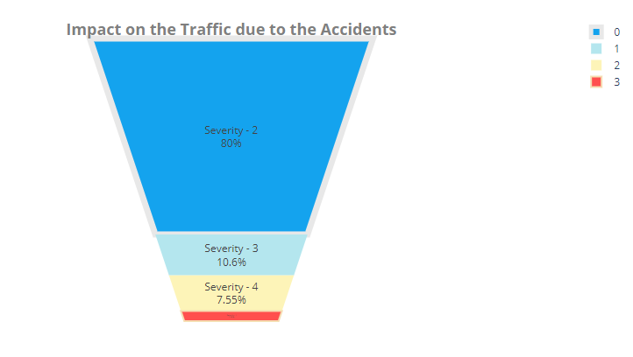

Slide 34
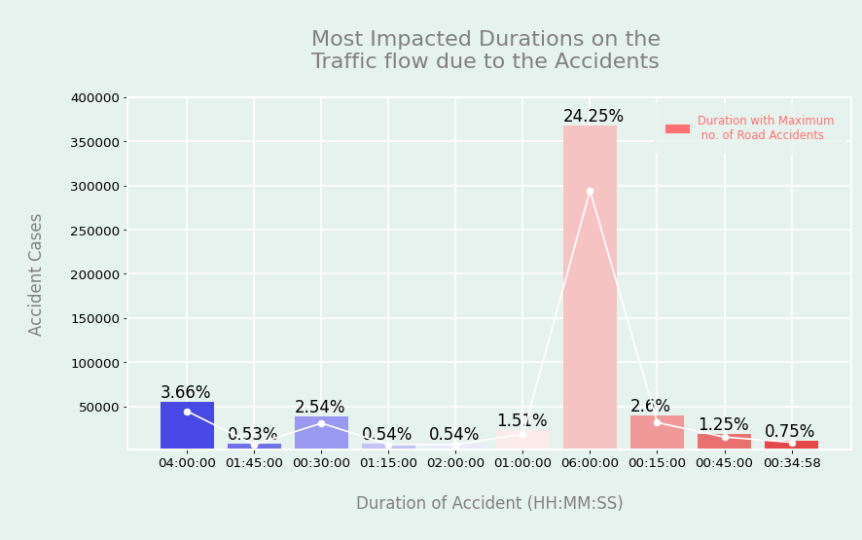

Slide 35
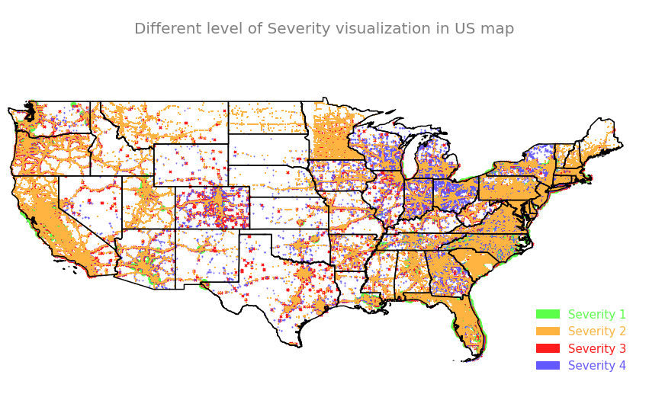

Slide 36
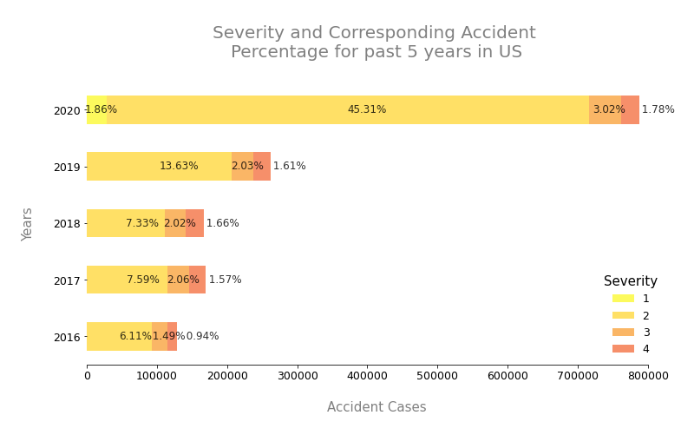

Slide 37
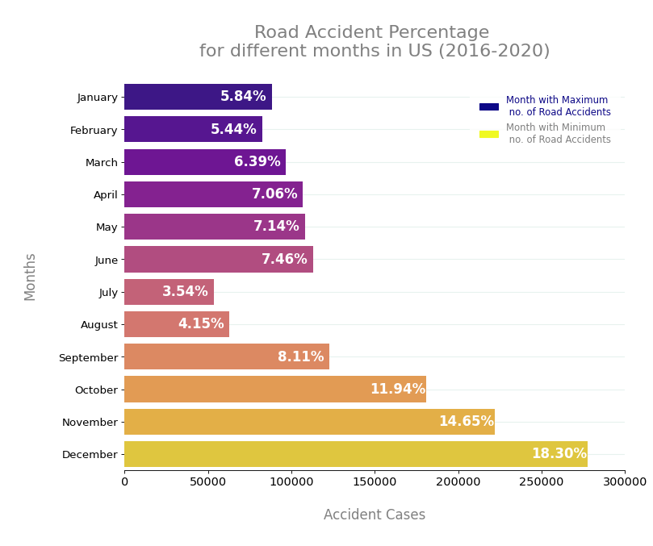

Slide 38
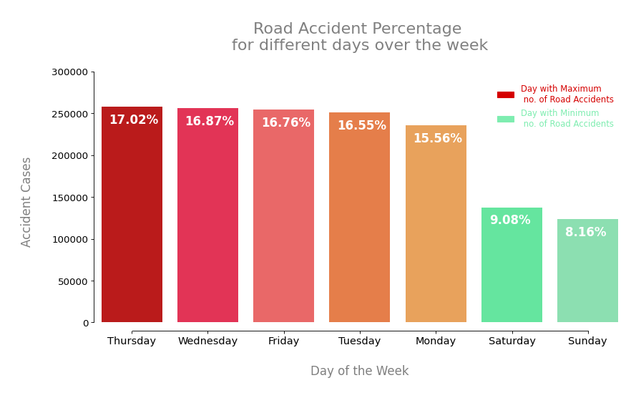

Slide 39
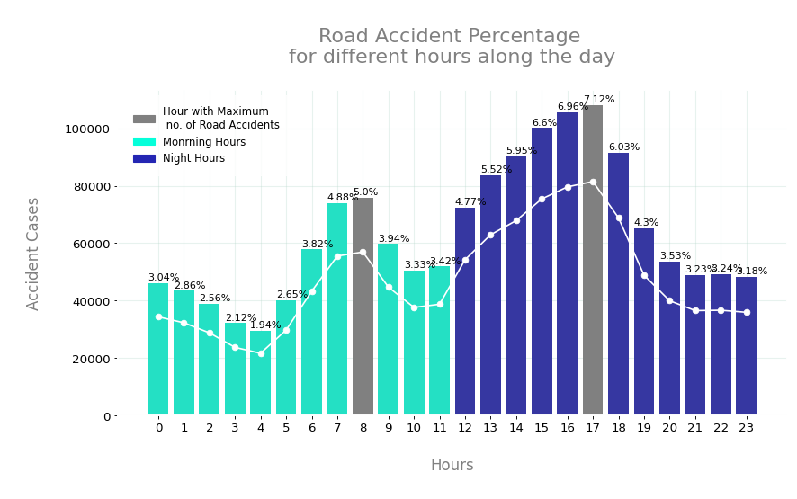

Slide 40
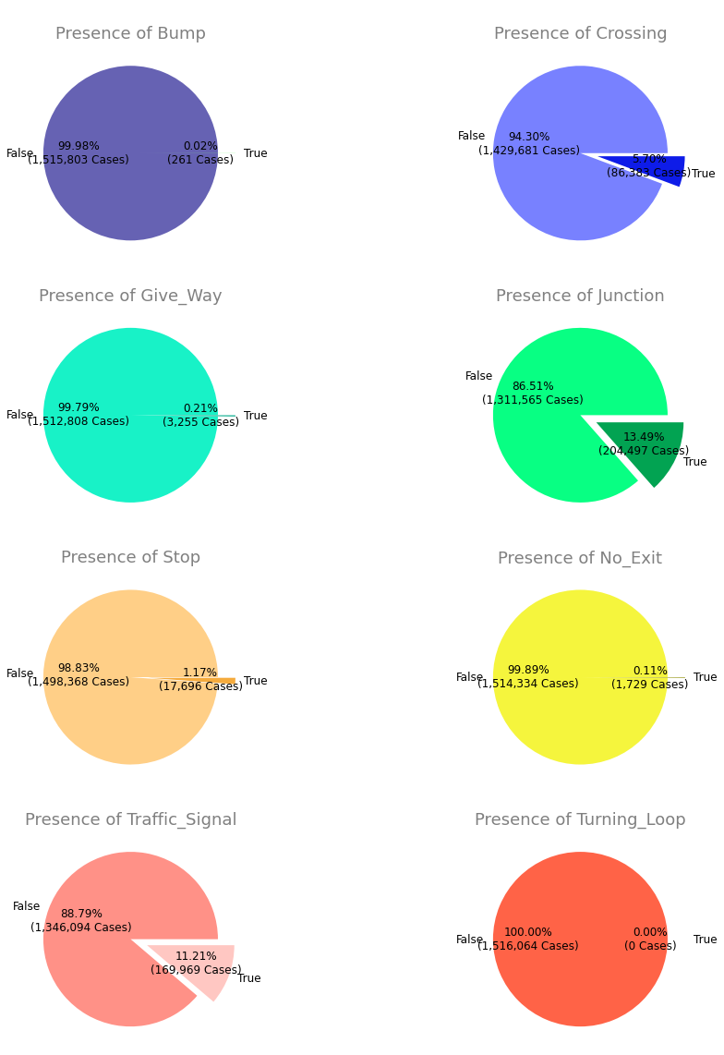

Slide 41
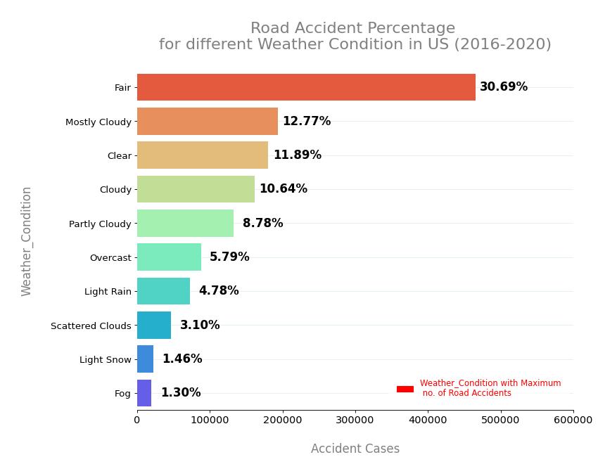

Slide 42
PROJECT TIMELINE – GANTT CHART
W1
W1
W2
W2
W3
W3
W4
W4
W5
W5
W6
W5
Dataset Selection
VINAY & AKHILESH
Data Attributes Identification
SANDEEP & VENKAT
Data Cleaning & Pre-Processing
NAVEEN, VINAY, VENKAT
Models & Optimization
ENTIRE TEAM – WINNNNER WINNNNNNNER!
Feature Identification & Future Scope
AKHILESH, NAVEEN
Data Visualization
VINAY, SANDEEP
Report Curation
VINAY, VENKAT

Slide 43
THANK YOU!

Slide 44
SUMMARY
Problem Specification | Data Characteristics | Models | Future Scope | What’s in data?
Nearly 1.25 million people die in road crashes each year
20–50 million people are injured or disabled annually
Divided data into 5 attribute categories: Traffic, Address, POI, Weather, POD
Models used:
LR
KNN
Decision Tree
Random Forest
Handling Class Imbalance
Explore Relationships
Analysis graphs of accidents across cities, states and timezones
Road traffic crashes rank as the 9th leading cause of death and accounts for 2.2% of all deaths globally
Type your scrum stories here. This is your story to be added here
Accuracy:
LR – 95.4
KNN – 93.5
DT – 96.8
RF – 97.4
Real time accident risk prediction
Explore Re-Sampling and Frequency Encoding
Analysis graphs of accidents over years, days, months, time
Type your scrum stories here. This is your story to be added here
Road crashes cost USD 518 billion globally, 1–2% of nation’s GDP
In the USA, over 37,000 people die in road crashes each year
Analyzed key features that are important according to the models
Analysis graphs of accidents due to place of accident, weather, etc

